Slide 1
Human rights- Vietnam

Slide 2
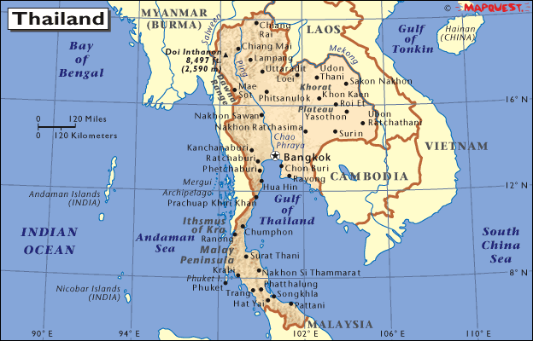
Vietnam
Southeastern Asia, bordering the Gulf of Thailand

Slide 3
Human Rights Abuse
1) The Vietnam War was the prolonged struggle between nationalist forces attempting to unify the country of Vietnam under a communist government and the United States (with the aid of the South Vietnamese) attempting to prevent the spread of communism. Engaged in a war that many viewed as having no way to win, U.S. leaders lost the American public's support for the war.
2) In 2009, Le Cong Dinh, a lawyer who several years previously had acted for the government in a successful case against American catfish farmers, was arrested and charged with the capital crime of subversion; several of his associates were also arrested. Many Western governments condemned the move, and human rights groups alleged that the arrest was due to Le Cong Dinh's support for freedom of speech. Amnesty International named him and his arrested associates to be prisoners of conscience.

Slide 4
Human Rights Comparison
Vietnam’s | Canada’s
^{Freedom of expression} Freedom of assembly Access to justice and the rule of law Death penalty Freedom of religion or belief Women’s rights Children’s rights | Fundamental freedoms Democratic rights Mobility rights Legal rights Equality rights Language rights Aboriginals people’s rights. Canadian charter of rights protects against discrimination

Slide 5
Political System:
Its current state constitution, which replaced the 1975 constitution in April 1992, asserts the central role of the Communist Party of Vietnam in all organs of government, politics and society.
The National Assembly of Vietnam is the unicameral legislature of the state, composed of 498 members. Headed by a Chairman, it is superior to both the executive and judicial branches, with all government ministers being appointed from members of the National Assembly. The Supreme People's Court of Vietnam, headed by a Chief Justice, is the country's highest court of appeal, though it is also answerable to the National Assembly. Beneath the Supreme People's Court stand the provincial municipal courts and numerous local courts. Military courts possess special jurisdiction in matters of national security.

Slide 6
Economic Development
In 1986, the government initiated a series of economic and political reforms, which began Vietnam's path towards integration into the world economy. By 2000, it had established diplomatic relations with most nations. Vietnam's economic growth has been among the highest in the world since 2000, and in 2011 it had the highest Global Growth Generators Index among 11 major economies. Its successful economic reforms resulted in it joining the World Trade Organization in 2007. However, the country still suffers from relatively high levels of income inequality.

Slide 7
National Makeup Of Vietnam
Kinh (Viet) 86.2%
Tay 1.9%
Tai Ethnic 1.7%
Mường 1.5%
Khmer Krom (Khơ Me Crộm) 1.4%
Hoa 1.1%
Nùng 1.1%
Hmong 1%
others 4.1%

Slide 8
Aspect of Globalization
Health and Medicine | -Health of children is very poor due to malnutrition, parasites etc. -Main causes of death: Drowning, malnutrition and parasite's. infant mortality rate: total: 20.24 deaths/1,000 live births
Environment | climate change and degradation of the ecosystem means the vulnerability of people to disaster vietnam is at high risk for: Flood 59% Storm 32% Drought 9%
Education | Education in Vietnam is divided into five levels: preschool, primary school, secondary school, high school and higher education. Formal education consists of twelve years of basic education. consists of five years of primary education, four years of intermediate education, and three years of secondary education.
Freedom and Equality | -Vietnam is primarily a source country for women and children trafficked for commercial sexual exploitation and forced labor. -There isn’t much freedom and quality because it’s a communist country.
Access to Technology | 45% of households in Vietnam have computers

Slide 9
Effects of Globalization on Women | What are the opportunities for women? | What are the challenges for women?
Quality of Life | accessing institutions, using property, getting a job, providing incentives to work, building credit, and going to court | women still have to handle all the housework.
Labor | the labor user is not allowed to use female labor for heavy or dangerous jobs. | women earn 13 per cent less than men
Entrepreneurship | The Women, Business and the Law report presents indicators based on laws and regulations affecting women's prospects as entrepreneurs and employees. | 90% female entrepreneurs need loans, but its very hard to get a loan if you are a private owner.

Slide 10
 | Women | Children
How has globalization impacted(positively and negatively) children and women? | Almost the same equality. Yet they don’t get paid as much. | Can’t be forced into work. Can’t go to really good schools unless they are wealthy.
What is the relationship between the way women are treated and the way children are treated? | Over the years women have been getting better treatment | The children of Vietnam have been getting treated better.
What is the impact of Vietnam’s political structure and the human rights climate toward women and children? | Women are still getting treated differently but has come a long way. | Children are able to get an education, but only if their family can afford it.
What is the relationship between Vietnam’s economic situation and the human right climate toward children and women? | The women have the right to be involved in economic situations just like in Canada. | Good impact because the economy is good.

Slide 11
References:
http://www.ilo.org/asia/whatwedo/publications/WCMS_100456/lang--en/index.htm
http://www.gsdrc.org/go/display&type=Document&id=4280
http://www.en.luathongduc.com/summary-vietnamese-labour-law
http://www.ilo.org/global/about-the-ilo/newsroom/news/WCMS_008091/lang--en/index.htm
http://www.lib.berkeley.edu/SSEAL/SoutheastAsia/seaviet.html
http://laborrights.org/creating-a-sweatfree-world/changing-global-trade-rules/state-sponsored-forced-labor-in-vietnam-drug-

